Slide 1
Exo-SIR: An Epidemiological Model to Analyze the Impact of Exogenous Spread of Infection

Slide 2
Introduction
An epidemic is a disease that spreads rapidly to a large number of people in a given population within a short period of time.
Epidemics like Covid-19 and Ebola have impacted people’s lives greatly.
To study the spread of these epidemics we use various compartmental models.
Some of famous compartmental model include SIR model and its variations.

Slide 3
Analogy
Information diffusion in online social networks is similar to the way the virus spreads in a population
Information Flows internally in network same as virus spread internally over the population
In Information Network Information from external sources can be considered analogous to exogenous virus spread.

Slide 4
SIR Model
The SIR model is one of the simplest compartmental models, and many models are derivatives of this basic form. The model consists of three compartments:- S, I , R
Assumptions of SIR Model:
Total Population Remains Constant
Rate of increase in infective is proportional to the contact between susceptible and infective
Infective Recover/die at constant rate

Slide 5
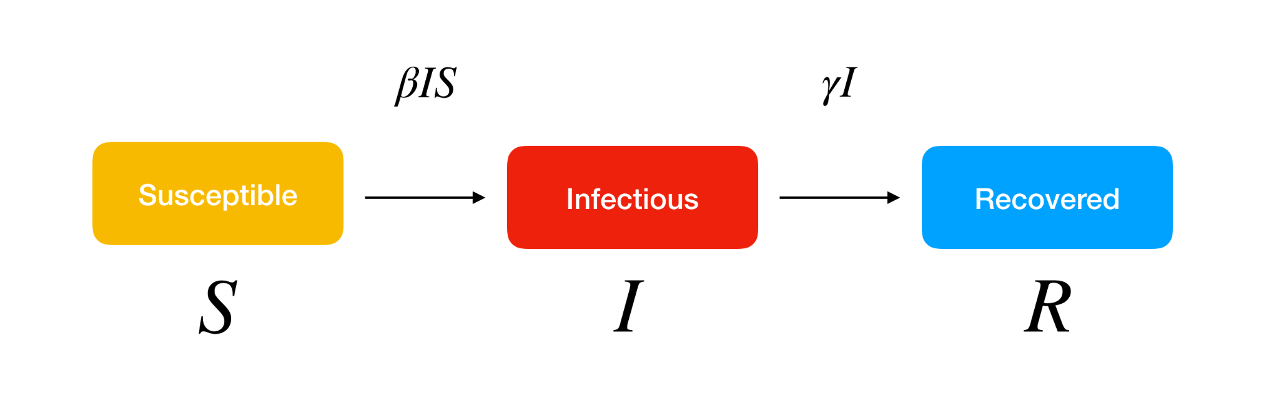
SIR Model
Based on the Assumptions following Equations are formed
s(t) + i(t) + r(t) = 1
ds /dt = −βsi
di/ dt = βsi − γi
dr/ dt = γi

Slide 6
Drawbacks
The SIR model describes the spread of the virus from people to people within the population under consideration.
SIR Model does not consider any external source of infection.
World Health Organization (WHO) has identified external transmission as one of the three modes of transmission.
In case of the spread of epidemics, even if there is a small increase in the number of infected people, the impact grows exponentially with respect to time. Hence, considering the exogenous infections while studying the dynamics of epidemics is very important.

Slide 7
Exo-SIR model
Difference between Exo-SIR model and SIR model
1. Two different types of infected nodes – Infected from exogenous source and Infected from endogenous source.
2. It differentiates between the spread from endogenous and exogenous sources.
The advantage of the Exo-SIR model over SIR model is that we can observe the endogenous and exogenous diffusion separately.

Slide 8
Exo-SIR model Notations
S - state of susceptible
Ix - state of infected from exogenous source
Ie - state of infected from endogenous source
R - state of recovered
ix - Fraction of nodes that are infected from exogenous source

Slide 9
Exo-SIR model Notations
ie - Fraction of nodes that are infected from endogenous source
r - Fraction of nodes that are recovered
βx - Rate at which the exogenous source infects the nodes
βe - Rate at which the nodes infects other nodes
γ - Rate at which the nodes get recovered

Slide 10
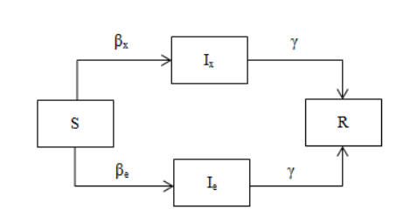
Exo-SIR model State transition diagram
State transition diagram of
the nodes in the Exo-SIR model.

Slide 11
Exo-SIR model Equations
ie + ix = i
s + i + r = 1
ds/dt = −βxs − βesi
dix/dt = βxs − γix
die/dt = βesi − γie

Slide 12
Exo-Sir Model for Disagreement
This scenario occurs when people do not behave according to the way the Government orders. For example, not wearing masks, not following social distancing, etc.
This can be represented in the Exo-SIR model by reducing the βe value.

Slide 13
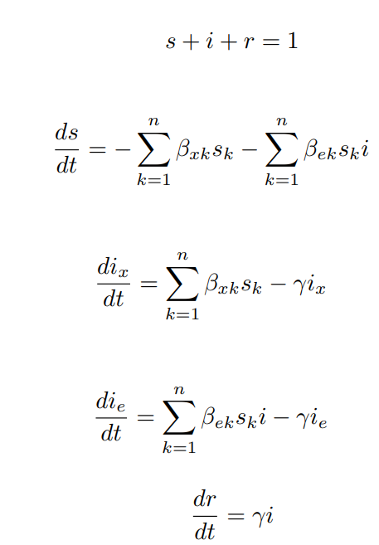
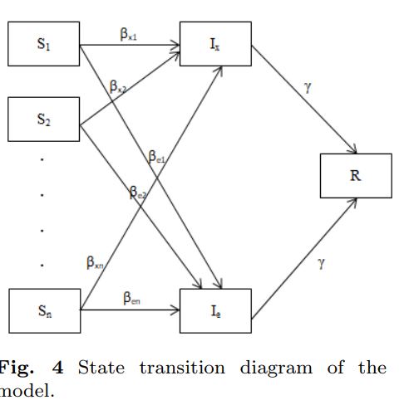
Exo-SIR model with multiple groups that have different risk of infection

Slide 14
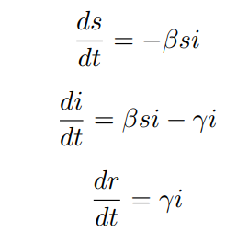
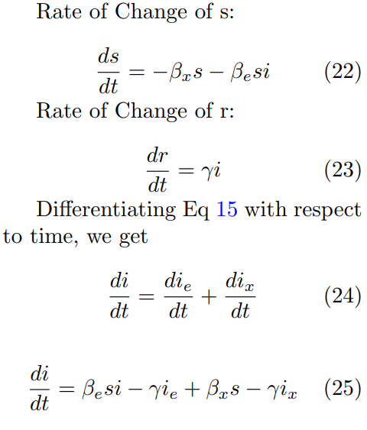
Comparison for SIR and Exo-SIR Model

Slide 15
Key Equations
di/dt = βes(ix + ie) + βxs − γ(ix + ie)
This Equation made the change.Here, even if we assume that there is no infected people in the beginning – i.e. ie = 0 and ix = 0, we get the following
di/dt = βxs which shows of an initial outbreak i0 which is not there in SIR model.

Slide 16
Key Equations
die/dt = βes(ie + ix) − γie
From this equation it can be seen that die/dt will be greater for ix>0 than from ix=0.
This means that the presence of exogenous diffusion causes endogenous diffusion to increase

Slide 17
Case Study 1: Covid 19 in india
Exo-SIR model is applied on real dataset regarding the spread of the Covid-19 pandemic in the Indian states of Rajasthan, Tamil Nadu, and Kerala from 14th March, 2020 to 14th April, 2020.
we analyze the data from the states of Tamil Nadu, Rajasthan, and Kerala. We compare the peak tick and peak value of the plot of ie in the presence and absence of ix.
In Tamil Nadu Exogenous spread dominates endogenous spread (ie ≪ ix),
In Rajasthan Endogenous spread dominates exogenous spread (ie ≫ ix),
In Kerala, both the endogenous and exogenous spread have roughly the same prevalence(ie ≈ ix)

Slide 18
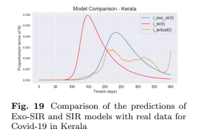
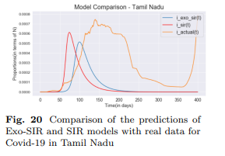
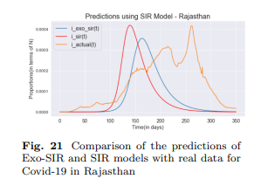
Case Study 2: Comparison Of Exo-Sir and Sir
Exo-SIR model predicts the time of the peak better
than the SIR model
mmmllmmm

Slide 19
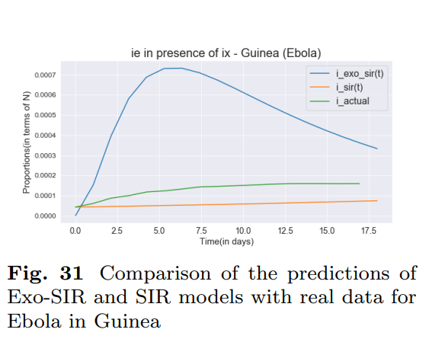
Case Study 2: Ebola Virus
In this graph it can be seen that SIR
Model predict constant infected people
But Exo-Sir model predicts a peak and
Infected people change over time.
Also can be seen that peak comes
At nearly same for actual and exo-sir
Model between 75-100 days.

Slide 20
Other Compartmental models for Covid-19 modeling
Compartmental models are used for analysis and prediction of Covid-19 dynamics.
The SIR model is one of the seminal compartmental models.
In QSIR model we have an extra state that represents the number of people in Quarantine.
SPCIRD model adds three extra states – P, C and D, where P represents the number of susceptible people who are partially controlled, C represents the number of susceptible people, D represents the number of people who died.

Slide 21
Other Compartmental models for Covid-19 modeling
Multiple epidemic wave model models the multiple waves of infection that could occur.
Time Dependent SIR model considers the constants in SIR model - beta and gamma to be varying with respect to time
none of these models take care of infections arising from outside the population

